Slide 1

Endings
Endings are difficult and challenging especially if a child or young person has not had good experiences of endings in their life previously.
Notes:
NOTES:
Children
Resistance to endings
May sabotage ending
May stop engaging and refuse to see you
May regress to old patterns of behaviour
May share new disclosures
May become dismissive of you, your work, your relationship
YOU
Be mindful of your own feelings related to closure
Have your own self-care system in place
How will you remember the child? Keep them in mind
Professional self-doubt
Acknowledge counter intuitive nature of endings
EACH SESSION
* Have a routine for ending each individual session to prepare them for final session – rehearsal for the main ending

Slide 2
Unplanned Endings
Unplanned endings are when support comes to an abrupt stop. This can occur for varied reasons such as; consent is withdrawn, the child/young person stops engaging or the worker becomes poorly and will be off work for quite some time.

Slide 3

Unplanned Endings
Unplanned endings can be difficult for both child/young person and worker alike as none of the emotional, physical and psychological safety of a planned ending occurs. Many emotions can arise as a result, e.g. sadness, relief, anger or frustration. It is important that these are acknowledged, voiced and openly discussed, e.g. via supervision and, if appropriate, with the child/young person themselves.

Slide 4
Covid-19
As a result of the pandemic there may be an increase in the numbers of unplanned endings that professionals and children are experiencing. When sessions come to an end in this way it can be even more challenging as things are totally out of our control.

Slide 5
A Good Enough Ending
If it is possible and appropriate try and pre-warn the child or young person about the need to end contact before your final contact. This gives the child or young person the time to take in the information and process any thoughts and feelings they may have, it also enables them to come to the final contact knowing what to expect, and to bring any worries or questions.
Try and contact the child or young person via the telephone, email, text or virtual meeting. If this is not possible and it is appropriate send a letter.
Try and establish a good time of day for the child or young person to engage with a virtual/telephone meeting. Encourage the meeting to take place in an environment which is quiet and as free from disruption as possible, and as private as is appropriate.

Slide 6
A Good Enough Ending
Discuss the change in circumstances and why contact has to end. Be honest about reasons, and make these age appropriate.
Highlight the positives from the previous contacts; you might be able to show them work you completed together, recall time spent together. You might want to thank them for something ‘thanks for turning up I enjoyed spending time with you’.
Share your own experiences of unplanned endings and how they have made you feel in the past, such as sad, relieved, worried, and or frustrated. Share any feelings you have about the current ending if appropriate. Encourage the child or young person to share their thoughts, feelings and worries with you. Be sure to really listen without judgement.

Slide 7
A Good Enough Ending
It may be appropriate to ask questions about their thoughts and feelings. ‘How are you feeling’ ‘I guess you might be wondering…’
Validate the things they share with you. ‘I understand you are worried about….’ ‘It is normal to feel sad….’
It is ok to not have all the answers to questions, just be honest about what you know.
If possible ensure the child or young person knows where to access help and support, including telephone numbers and websites, if they need it in the future, following this up in an email, text or letter confirming this information.
Marking the ending in some way can be helpful, this could be with a card or similar which lets the child or young person know you felt the time you had together was positive and meaningful, and that you valued their engagement.

Slide 8
A Good Enough Ending
Lastly….
Talk to your manager / supervisor about e.g.:
- how you are feeling
- making a plan for the case moving forward, e.g. put case on hold and pick it up again once you are allowed
- possibly sending them a care package of some of their favourite things if finances allow, e.g. play doh / pot of slime / paint

Slide 9

Practical tips for professionals
Whatever decision is made about continuing support it is really important to:
Get their work back to them either by post or talking to your manager about allowing you to undertake a single, one off session, once lock-down has been lifted so you can return their work to them in person and say goodbye properly.
Write a letter acknowledging all the work you have done together, that you will still be thinking of them and, if appropriate, that you will see each other again when sessions can start again.

Slide 10
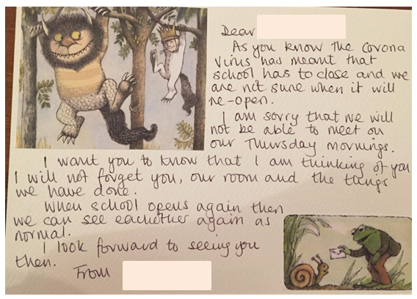
Sample Letter

